Slide 1
Weekly Meeting
Grace Sian
Sept 22, 2025

Slide 2
Weekly research progress
Finished
Abstract - Introduction
Gunshot data compared to paper
MATLAB code
On-going
Recording Data [40%]
Writing paper draft for 2026 VFS [30%]

Slide 3
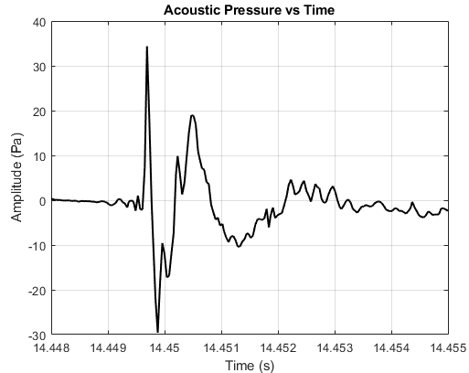
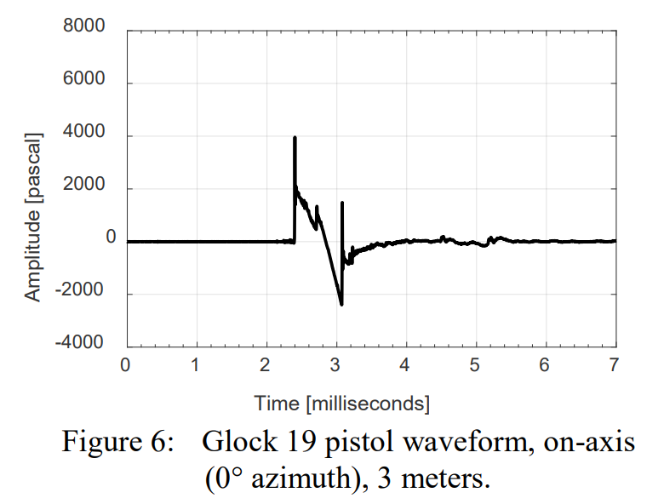
Result
Our gunshot data
Maher, R. C., and Routh, T. K., 2017, “Gunshot Acoustics: Pistol vs. Revolver,” Audio Engineering Society.

Slide 4
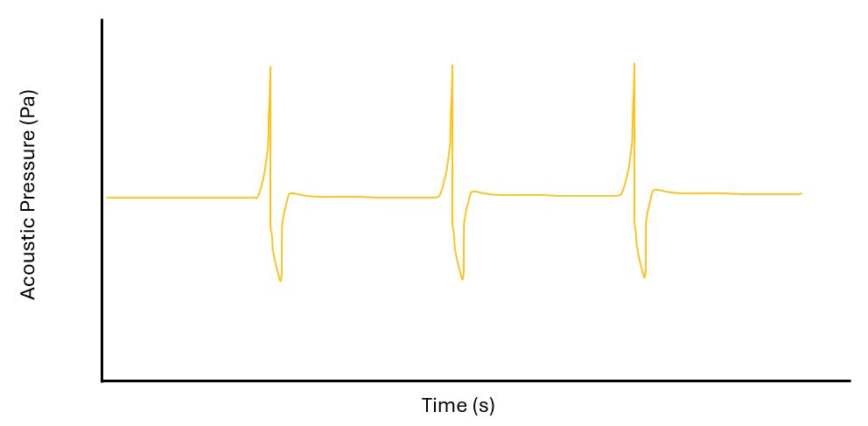
Result (expected and collected)
Last week expected result
This week result

Slide 5
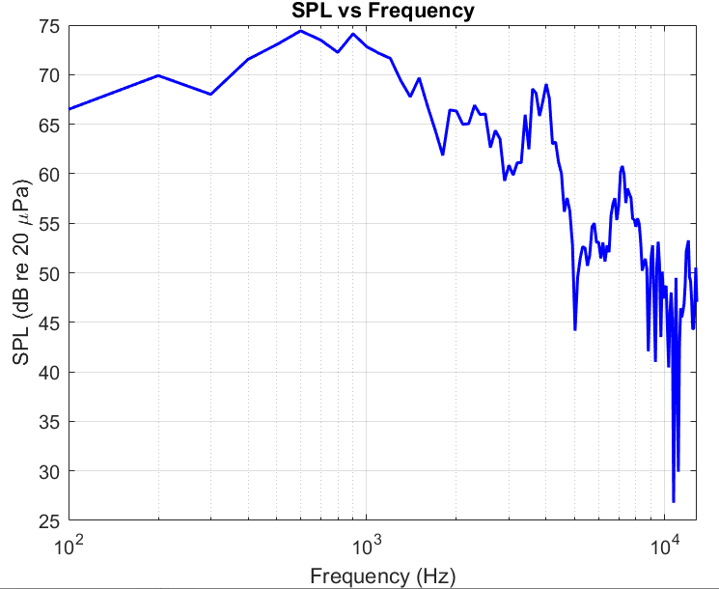
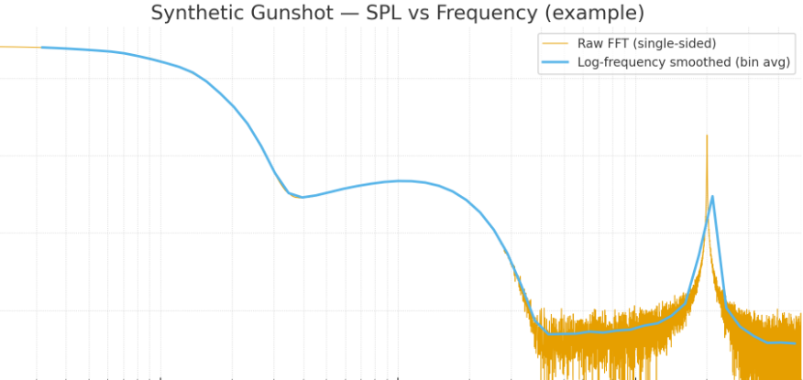
Result (expected and collected)
ChatGPT example gunshot SPL vs Freq
Our gunshot data SPL vs Freq

Slide 6
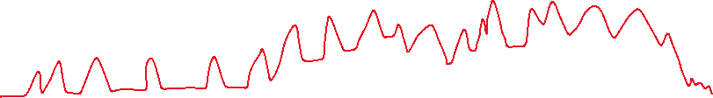

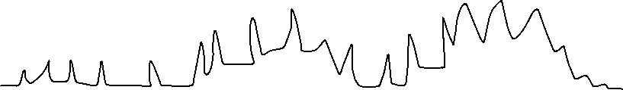

Visualized figure for VFS abstract (next week)
Prop
SPL (dB)
gunshot
gunshot
Prop + gunshot
Frequency (Hz)

Slide 7
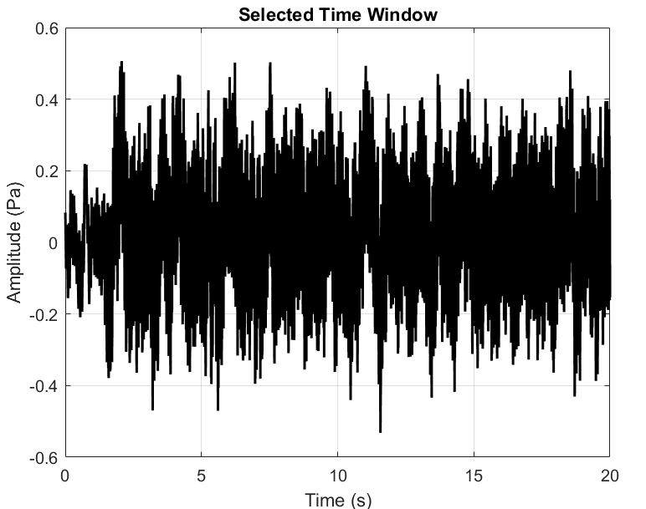
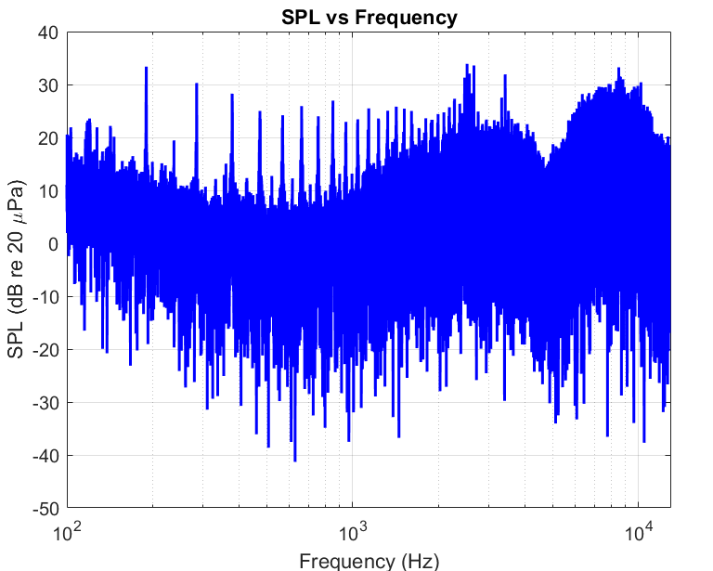
Prop only
22Sep_16in_proponly_0deg 2850RPM 1 lbf

Slide 8
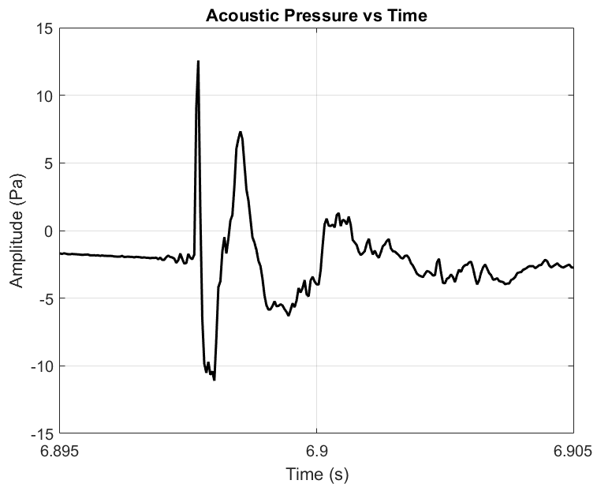
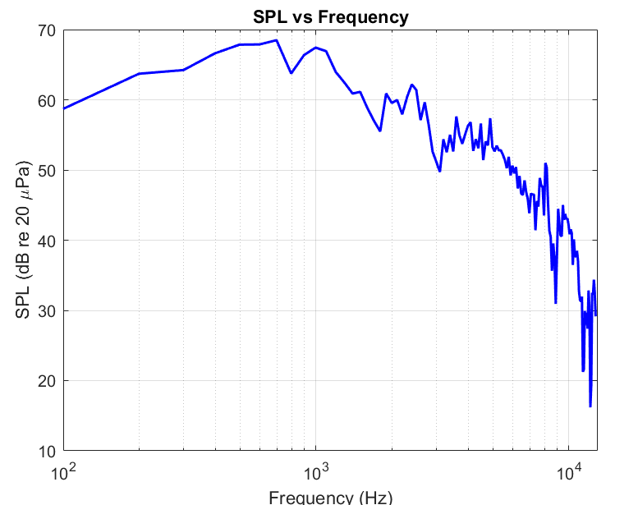
Gunshot only

Slide 9
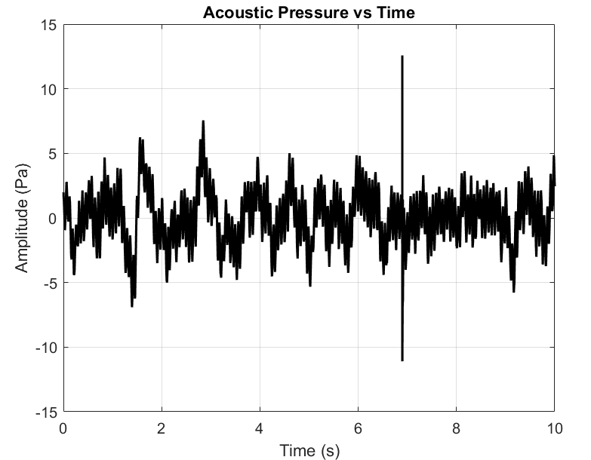
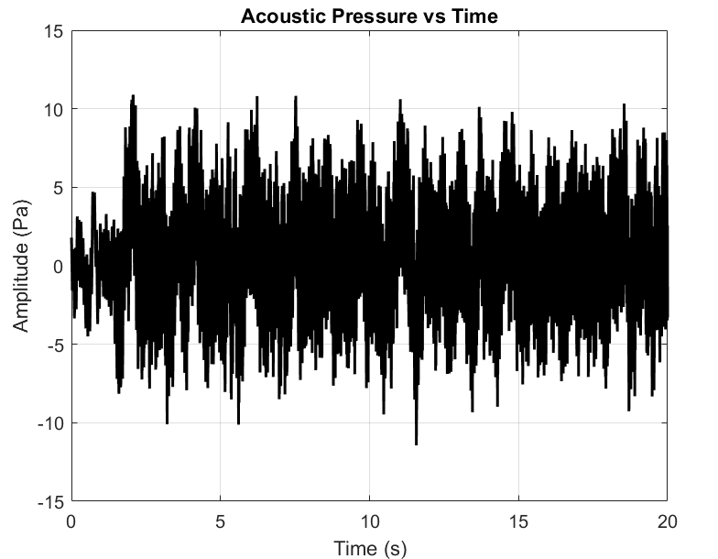
Gunshot prop amplitude comparison (89)
gunshot AP vs time (not avg)
Propeller AP vs time (not avg)

Slide 10
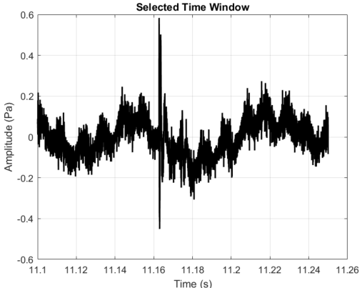
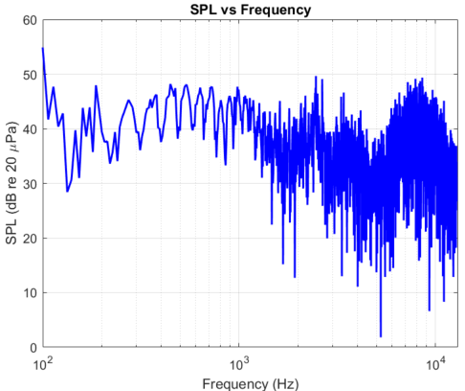
Both (89)

Slide 11
Weekly self evaluation
Items | Self grading
I made quality result figures | 6
I become more knowledgeable in the research area | 6
I made sufficient weekly progress towards publication goals | 6
Grading in the scale of 1~10
Additional comments if any

